Slide 1
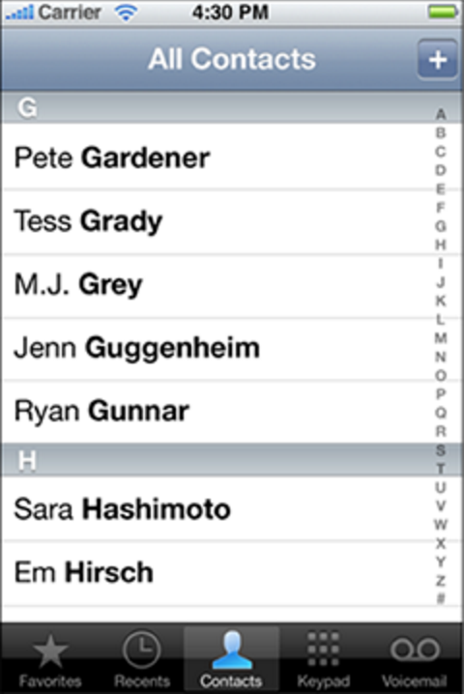
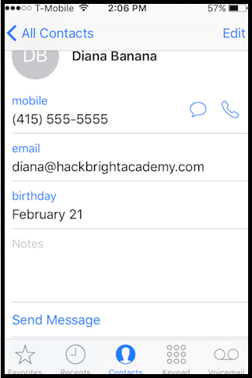
Code Appetizer
How would you model a contacts list using Python? What data structure would you use? Pseudocode it and then try it in Sublime!
Add a couple contacts.
Change the mobile number for one of the contacts to 888-888-8888.
Change the last name of one of your contacts to "Williams"
Notes:
Work on problem solving in the real world. Breaking down a problem and pseudocoding.

Slide 2
Code Appetizer
What were some observations or difficulties?

Slide 3
Code Appetizer - Add contacts
contacts[("Diana","Banana")] = {"mobile":"415-555-5555", "work":"415-888-5000","email":"diana@hackbrightacademy.com"}
contacts[("Amy","Smith")] = {"mobile":"415-555-5000", "work":"415-888-8000","email":"amy@hackbrightacademy.com"}
contacts[("Wes","Jones")] = {"mobile":"415-800-5000", "work":"415-555-8000","email":"wes@hackbrightacademy.com"}
Tuple as the key
Value is another dictionary.
Notes:
There are different ways you could model this data, so here’s one option with using a dictionary within a dictionary.

Slide 4
Code Appetizer - Access contact
contact1 = contacts[("Banana","Diana")]
print contact1 ⇒
{'mobile': '415-555-5555', 'work': '415-888-5000', 'email': 'diana@hackbrightacademy.com', 'birthday': '2/21/1990'}

Slide 5
Code Appetizer - Update contact
Access the mobile number:
contact1 = contacts[("Banana","Diana")]
mobile_number = contact1["mobile"]
print mobile_number ⇒ 415-555-5555
Update the mobile number:
contact1["mobile"] = "888-888-8888"

Slide 6
Code Appetizer - Difficulties
What if you want to change the last name because you spelled it wrong? You can’t since it’s a tuple.
This data seems a bit too complex for this data structure. It’s somewhat difficult and confusing to use.
Dictionaries also do not give us the ability to model behavior/functionality that we may want. Ex. Send email, send text, share contact, etc.

Slide 7
Code Appetizer - Conclusions
We want to be able to access and update every piece of information in a Contact, including the first and last name.
We also want to be able to model behaviors like Send Email, Send Text, and Share Contact.
We can do all this by using a Class!
Notes:
this works, but isn’t great

Slide 8
Agenda
6:45pm - Code Appetizer
7:15pm - Lecture Part 1
7:45pm - Activity 1
8:05pm - Break time
8:15pm - Lecture Part 2
8:40pm - Activity 2
9:10pm - Survey

Slide 9
Goals
Introduction to Classes
Creating a class
Using classes
Using classes as modules

Slide 10
Classes

Slide 11
Classes
Classes are user-defined data structures that provide the ability to model data and functionality.

Slide 12
Classes in 3 steps
Create a class which is a template of data and functions that is well associated
Instantiate an instance of the class, which is called an object
Use the object by calling methods and accessing attributes defined in the class

Slide 13
Step 1 - Create a Class
class Contact(object):
def __init__(self, first_name, last_name):
self.first_name = first_name
self.last_name = last_name

Slide 14
Step 1 - Create a Class
class Contact(object):
def __init__(self, first_name, last_name):
self.first_name = first_name
self.last_name = last_name
Note that we use “CamelCase” to designate that Contact is a class (unlike variables and functions for which we usually use snake_case).

Slide 15
Basic Class Recipe
class Contact(object):
def __init__(self, first_name, last_name):
self.first_name = first_name
self.last_name = last_name
class - Tells the computer you want to create a class. Contact - The name of the class you are making. (object) - What the class inherits from. For now, just type this exactly. __init__ - A special method that gets run when you create an instance of a class self - Refers to the particular instance of the object you are creating. You don’t pass an argument for self, Python automatically assumes what self is. self.first_name - Variables part of the instance are called attributes.
Notes:
Don’t worry too much about object and self. For now think of them as standard conventions that must be used.
This is the most basic necessity of a class. However, there is a lot more that will be added to it.

Slide 16
The __init__ method
What parameters should go into the __init__ method?
Generally, only the values that are necessary to create a new instance.
class Contact(object):
def __init__(self, first_name, last_name):
self.first_name = first_name
self.last_name = last_name
Notes:
Not all Contacts may have an email, work phone, or birthday, but a Contact needs to have a first and last name. The self.X instance variables are being initialized with values here.

Slide 17
The __init__ method
Remember optional parameters? You can use them when defining the __init__ method!
class Contact(object):
def __init__(self, first_name, last_name, email = "", mobile_phone = ""):
self.first_name = first_name
self.last_name = last_name
self.email = email
self.mobile_phone = mobile_phone
Notes:
Not all Contacts may have an email, work phone, or birthday, but a Contact needs to have a first and last name. The self.X instance variables are being initialized with values here.

Slide 18
Create a Class (cont.)
Let’s keep adding to our class! We can add functions and more variables.

Slide 19
Classes - Attributes
Variables that are part of the class are called attributes. These are denoted with self.variable_name
class Contact(object):
def __init__(self, first_name, last_name):
self.first_name = first_name
self.last_name = last_name
Notes:
You may want to add variables(attributes) that are useful to your class, but are not required in creating a new instance. The rule of thumb is, don't introduce a new attribute outside of the __init__ method, otherwise you've given the user an object that isn't fully initialized.

Slide 20
Classes - Methods
Classes can contain functions. These are called methods.
class Contact(object):
def __init__(self, first_name, last_name, email):
self.first_name = first_name
self.last_name = last_name
self.email = email
def send_email(self, message):
print "To: %s - %s" % (self.email, message)
Notes:
Notice how the send_email method is able to make use of the attribute self.email even though it is NOT a parameter to the method! All variables in the class are useable throughout the class!

Slide 21
More on self
self is how we refer to things in this instance of the class.
self is the first parameter in any function defined inside a class.
To access these functions and variables elsewhere inside the class, their name must be preceded with self and a dot. (e.g. self.variable_name).

Slide 22
Exercise Time!
Do Activity 1 in the portal.
Notes:
It’s your turn to try to recreate the Contact class.

Slide 23
Step 2 - Instantiate an Instance
Now that we know how to define a new class, let’s use it!
After a class is defined, it can be used by instantiating an instance of it. The resulting instance is called an object.

Slide 24
Instantiate an Instance of the Class
class Contact(object):
def __init__(self, first_name, last_name):
self.first_name = first_name
self.last_name = last_name
contact_diana = Contact("Diana", "Banana")
Notes:
Notice values are passed in that correspond to the parameters "first_name" and "last_name" but not "self"
diana_contact is now an object that holds an instance of Contact.

Slide 25
The __init__ method
Notice the __init__ method isn’t called explicitly. It is automatically called when an instance is created!

Slide 26
Instantiate an Instance of the Class
class Contact(object):
def __init__(self, first_name, last_name):
self.first_name = first_name
self.last_name = last_name
contact_diana = Contact("Diana", "Banana")
Variable assigned with the Contact object.
Name of the class we want to create an instance of.
Arguments to the __init__ method. Notice how there is not an argument that maps to the self parameter.
Notes:
Notice values are passed in that correspond to the parameters "first_name" and "last_name" but not "self"
This looks similar to the convention for calling a function.

Slide 27
Class vs Object
A class is like a blueprint for building a house. By itself, it doesn’t do anything.
An object is a house built by using the blueprint.
Notes:
Similarly, a function is a set of instructions often with parameters. It doesn’t do anything on it’s own. It must be called with values passed in as parameters for its instructions to be run.

Slide 28
Create many instances...
class Contact(object):
def __init__(self, first_name, last_name,
mobile_phone = "":
self.first_name = first_name
self.last_name = last_name
Self.mobile_phone = mobile_phone
contact_diana = Contact("Diana", "Banana","555-555-555")
contact_amy = Contact("Amy", "Smith")
contact_wes = Contact("Wes", "Jones")

Slide 29
Step 3 - Use the object
After an object is created, we can call the methods that we defined in the class.
contact_diana = Contact("Diana", "Banana")
contact_diana.send_email("Hi! How are you?")

Slide 30
Access the attributes
After an object is created, we can access and change the attributes in the class.
contact_diana = Contact("Diana", "Banana")
contact_diana.last_name = "Williams"
contact_diana.mobile_phone = "888-888-8888"
print contact_diana.last_name ⇒ Williams
Notes:
In order to print the attributes, you must access each one.

Slide 31
Use with other data structures
These objects are just another type of data that can be stored in other data structures too. Let’s add 3 Contact objects to a list and iterate through the list.
contact_diana = Contact("Diana", "Banana") contact_amy = Contact("Amy", "Smith") contact_wes = Contact("Wes", "Jones") contact_list = [] contact_list.append(contact_diana) contact_list.append(contact_amy) contact_list.append(contact_wes)
for info in contact_list: print info.first_name

Slide 32
Classes are a Type
class Contact(object):
def __init__(self, first_name, last_name):
self.first_name = first_name
self.last_name = last_name
contact_diana = Contact("Diana", "Banana")
print type(contact_diana) ⇒ <class 'contact.Contact'>
Notes:
Call the type() function on a class object.

Slide 33
Importing a Class
We can also use the class in other files by importing it in a different file.
import contact
The name of the file without the .py extension
Notes:
Do a quick demo.

Slide 34
Summary on Classes
A class is a container for shared variables and functions. These variables called attributes are accessible to all the methods from within the class without having to be passed as parameters.
Classes keep code organized.
Classes allow for more complex modelling of data and functionality, which mirrors the real world more closely.
Just like any other data structure, use classes only when it makes logical sense.
Notes:
Classes are an advanced topic that takes some repetition for it to sink in. It’s a worthy topic because it scratches the surface of OOP (object oriented programming).

Slide 35
Classes Terminology
Object
An instance of a Class.
Attributes
Variables of a class such as name, email, weight, etc.
Methods
Functions that act on an object.
Instantiating is developer speak for creating an object.
The __init__ method is automatically called when creating an object. This method initializes attributes with values.

Slide 36
Exercise Time!
Do Activity 2 in the portal.

Slide 37
Exit Survey
Please give us your feedback by filling out the survey on your portal. Thanks!

